Slide 1
Big Data Analytics - An Academic Perspective
Ramesh Ragala
VIT Chennai

Slide 2
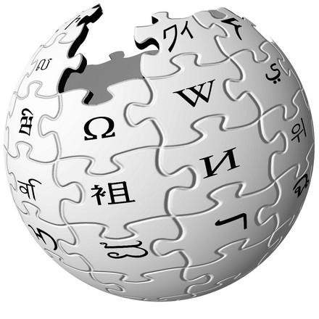



Introduction – Big data and Machine Learning
1.3 Billion active users
Users
5.40 Million
Wikipedia Articles
1 billion user
300 hours of videos per minute
3.5 Millions new images every day
Problem in Machine Learning

Slide 3
Continue…
Vertical Scaling
Horizontal Scaling

Slide 4
Parallelism
Wide variety of different parallel architecture
GPUs
MultiCore
Clusters
Design and implement parallel learning Systems???
Low Level Parallel Primitives
Threads, Locks and Messages.
It tunes for a specific platform.
Difficult to extends
How do we design and implement learning systems?????

Slide 5
What is Big Data?
It’s the data that is too large, complex, and dynamic such that it is impractical for any conventional hardware and/or software tools and systems to manage and process.

Slide 6
What is Big Data?
Big data is the term for a collection of data sets so large and complex that it becomes difficult to process using on-hand database management tools or traditional data processing applications.
The challenges that we face with DBMS tools and other technologies is capture, curation, storage, search, sharing, transfer, analysis, and visualization.

Slide 7
Why Big data
Key enablers for the appearance and growth of ‘Big-Data’ are:
Increase in storage capabilities
Increase in processing power
Availability of data

Slide 8
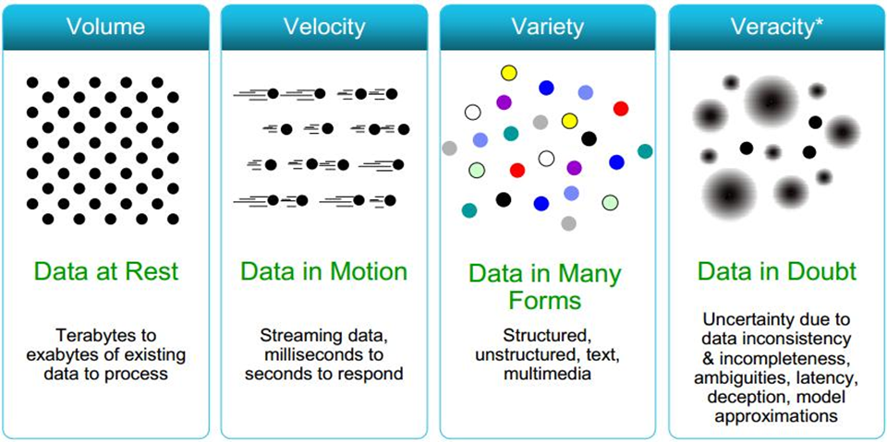
Characteristics of Big Data

Slide 9
Characteristics of Big Data
Volume: The amount of data is big.
Variety : Different kinds of data:
structured
semi-structured
unstructured
Velocity: Speed-issues to consider:
How fast is the data available for analysis?
How fast can we do something with it
Other V’s: Veracity, Variability, Validity, Value,. . .

Slide 10
Structured Data
Structured data
Pre-defined schema imposed on the data
Highly structured
Usually stored in a relational database system
Example
numbers: 20, 3.1415,. . .
dates: 21/03/1978
strings: ”Hello World”
Roughly 20% of all data out there is structured

Slide 11
Semi-structured Data
Semi-structured data
Inconsistent structure.
Cannot be stored in rows and tables in a typical database.
Information is often self-describing (label/value pairs).
Examples:
XML, SGML,. . .
BibTeX files
logs
tweets
sensor feeds

Slide 12
Unstructured Data
Unstructured data
Lacks structure or parts of it lack structure.
Examples:
multimedia: videos, photos,
audio files,. . .
email messages
free-form text
word processing documents
presentations
Reports
Experts estimate that 80 to 90 % of the data in any organization is unstructured
It is used in NLP, Parts of Speech Tagging, text analytics etc.

Slide 13
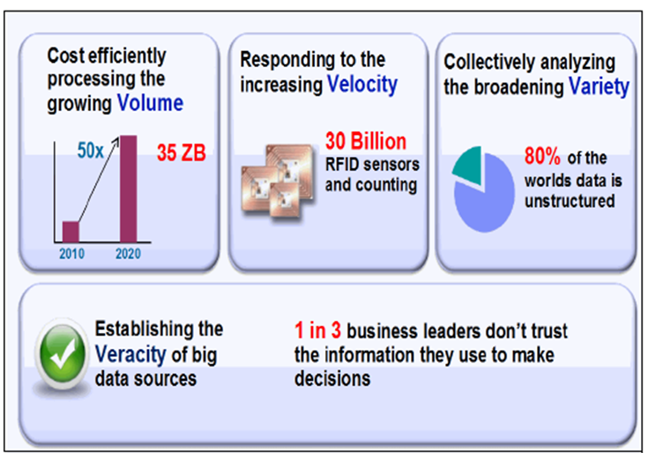

Challenges
The most challenging task is how to bring out valuable
insights from the large and complex data

Slide 14
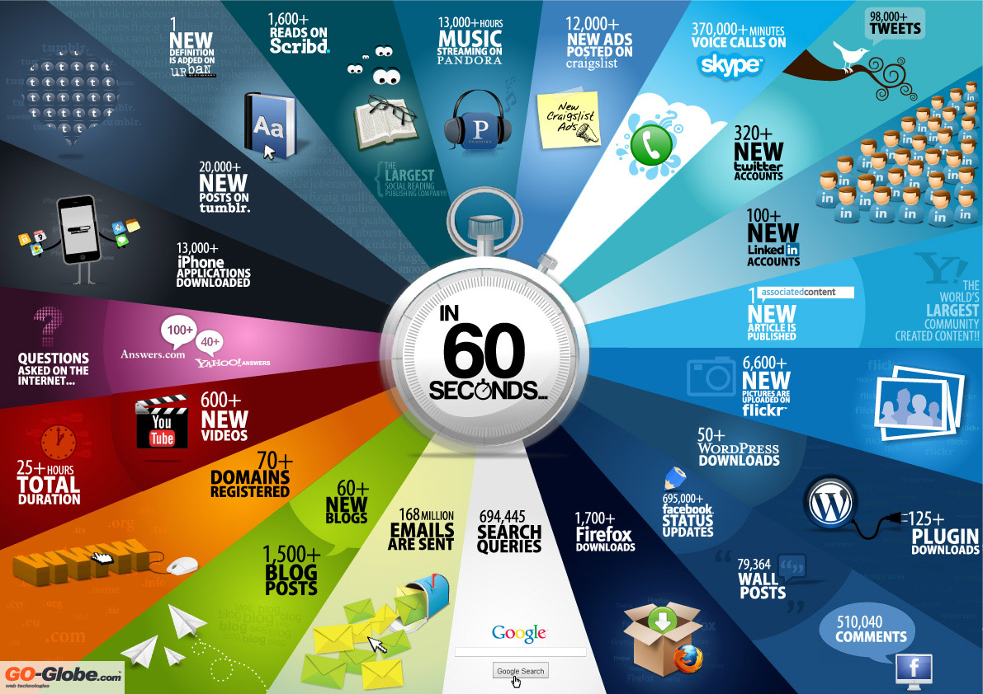
Things that happen in every sixty seconds ref: http://www.go-gulf.com/blog/60-seconds-v2/

Slide 15
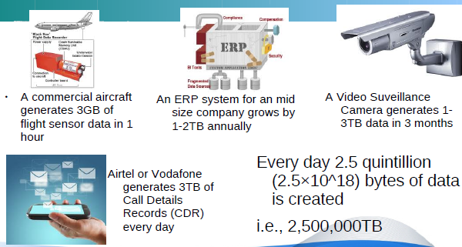
Continued…

Slide 16
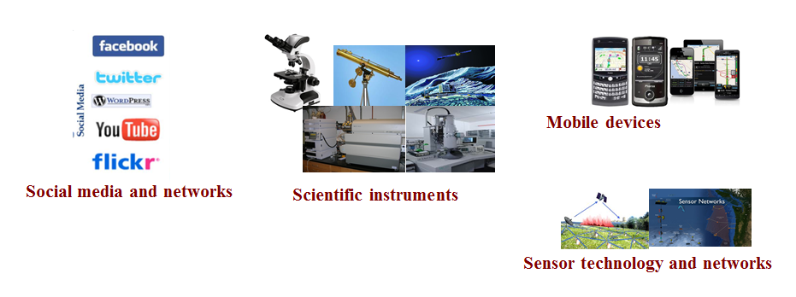
Why Big Data Analytics is buzzword now
Previously, the progress and innovation is not hindered by the ability to collect data but by the ability to manage, analyze, visualize, and discover knowledge from the collected data in a timely manner and in a scalable fashion

Slide 17
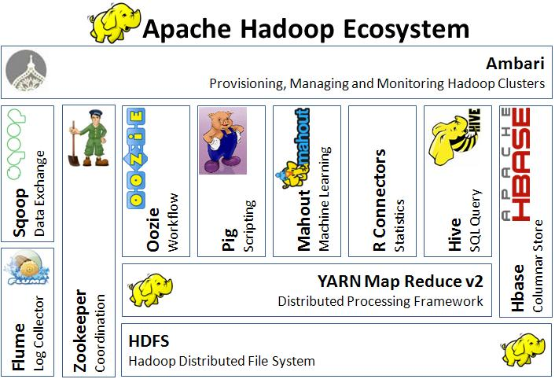
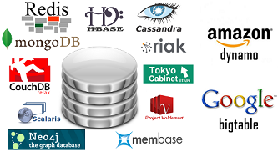





What enables us to work with Big Data Now
Availability of ecosystem of tools such as Hadoop
. V
To do
Scalable
fault tolerant
distributed storage
parallel processing
Structured, unstructured data
Batch as well as stream computing
To deal with

Slide 18







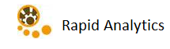


Continued…
Availability of specialized algorithms and software tools for
Machine Learning | Predictive analytics
Forecasting | Data optimization

Slide 19
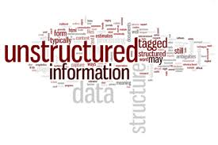









Continued…
Availability of variety of data visualization tools to communicate information clearly and effectively through graphical means.
jQuery Visualize

Slide 20
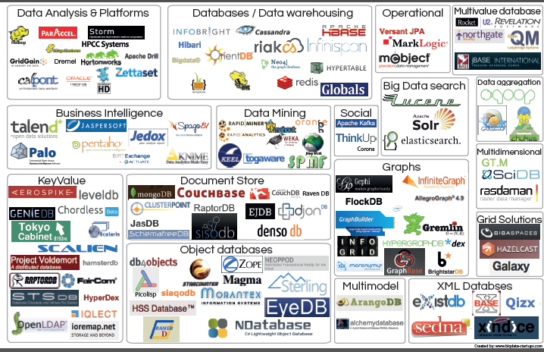
Open Source tools for Big Data http://www.bigdata-startups.com/open-source-tools/

Slide 21
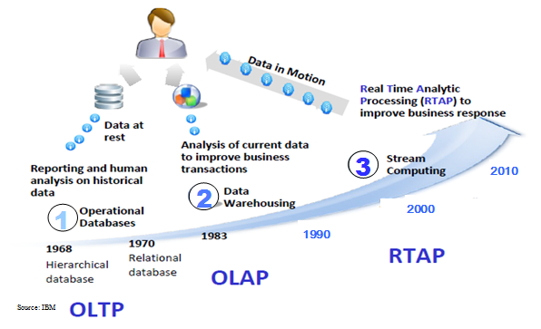
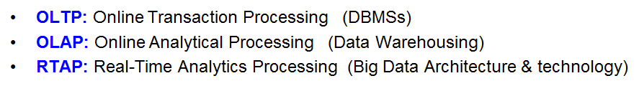
Harnessing Big Data

Slide 22

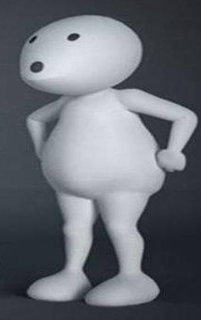
Are there any use cases of Big Data?
YES

Slide 23
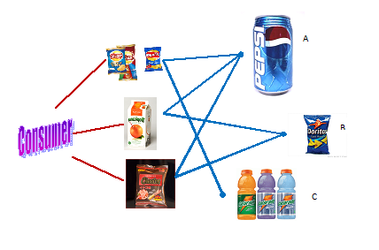
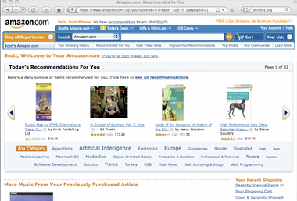
Recommender Systems
Amazon use customer click-stream data and historical purchase data of 152 million customers and each user is shown customized results on customized web pages.

Slide 24

Watson wins Jeopardy!
Watson was able to achieve this feat by using natural language processing and big data to comprehend the questions and then come up with the correct answer
http://www.siia.net/blog/index.php/2013/05/ibms-watson-graduates-from-winning-jeopardy-to-changing-healthcare/

Slide 25
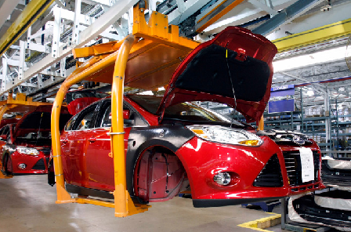
Ford
At Ford, big data is impacting the parts and features of those cars before they’re ever part of a design file.

Slide 26
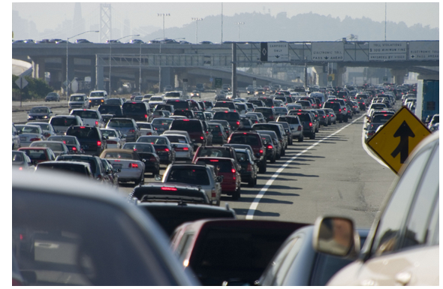
Traffic Analysis
Anyone who has driven in Los Angeles has experienced the traffic nightmare. The US government is using big data to keep traffic moving on the I-10 and I-110 freeways for drivers who are willing to pay for less congestion.

Slide 27

Health Care
Aetna, the insurance company that currently serves 18.2 million members, has a lot of data on its customers in the form of conditions treated (or billed for), prescriptions filled and the types of treatments doctors prescribe, and now it’s using that data to improve patient care.

Slide 28

Is Big Data ecosystem used only in Industry?
NO

Slide 29
Big data in Genomic Analysis
Three billion base pairs make up the DNA present in humans. It’s probably safe to say that such a massive amount of data should be organized in a useful way, especially if it presents the possibility of eliminating cancer.
Lynda Chin et al. explain that genome analysis using Hadoop leading to new cancer therapy targets and discoveries about certain cancer mutations and the medical responses they require.
http://genesdev.cshlp.org/content/25/6/534.full.pdf+html

Slide 30
Biomedical Image Processing
Scientists study the complex molecular interactions that regulate biological systems. The acquisition system has a data rate of 1.5 Mbps, and a typical 48 hour experiment can generate more than 260 GB of images, recorded as hundreds of multichannel videos each corresponding to a different treatment.
They are using hadoop technology to solve the above problem effectively.
Ref: https://cs.uwaterloo.ca/~ashraf/pubs/hpcs09scientific.pdf

Slide 31
Hadoop for safe disposal of Nuclear waste disposal
This work involves conducting molecular dynamics simulations of relatively large systems (50,000 atoms) with a fully reactive model for water to understand how radiation damage would affect how quickly nuclear waste forms would degrade.
They have used Hadoop for solving the problem.
Ref: http://glennklockwood.blogspot.in/2013/06/fortran-python-and-hadoop-for-safer.html

Slide 32
High-Energy Physics Analysis using Hadoop
They perform a Large Hadron Collider data analysis workflow using tools and data formats that are commonly used in the “Big Data” community outside HEP. These include Apache Avro for serialisation to binary files, Pig and Hadoop for mass data processing and Python Scikit-Learn for multi-variate analysis.
http://indico.cern.ch/event/214784/session/9/contribution/231.pdf

Slide 33
Who Plays significant role in demystifying the data for successful
Big data use cases
Data
Scientist

Slide 34
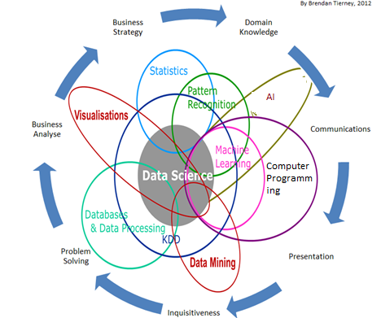
Data Science is Multidisciplinary
Data scientist should have minimum knowledge in these multi disciplinary areas

Slide 35
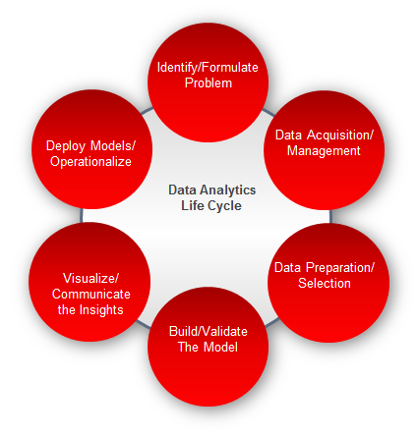
Data Analytics Life Cycle
Data scientist must understand the entire data analytics life cycle

Slide 36
What essential knowledge one need to have
to become
Data Scientist
Machine
Learning

Slide 37
Major Challenges for Data scientist
Formulating the problem and fitting into Machine learning or data mining paradigm
Domain knowledge in identifying the features that can represent the data
all the problems may not be easily expressed using MapReduce framework

Slide 38
Machine Learning Challenges
Unavailability of Labelled data
Incomplete, noisy, and inconsistent data
Assessing the expected error of a learning algorithm on a problem
Outlier / Anamoly detection
Data normalization and standardization
Dimensionality Reduction

Slide 39
Why is Machine Learning Important?
Some tasks cannot be defined well, except by examples (e.g., recognizing people).
Relationships and correlations can be hidden within large amounts of data. ML may be able to find these relationships.
Humans are unable to explain their expertise (speech recognition)
Human expertise does not exist (navigating on Mars),
Human designers often produce machines that do not work as desired in the environments in which they are not used.

Slide 40
Continued…
The amount of knowledge available about certain tasks might be too large for explicit encoding by humans (e.g., medical diagnostic).
Environments change over time.
New knowledge about tasks is constantly being discovered by humans. It may be difficult to continuously re-design systems “by hand”.

Slide 41
Issues in Machine Learning
What algorithms are available for learning a concept? How well do they perform?
How much training data is sufficient to learn a concept with high confidence?
When is it useful to use prior knowledge?
Are some training examples more useful than others?
What are best tasks for a system to learn?

Slide 42
Continued…
What is the best way for a system to represent its knowledge?
How can we optimize the accuracy on future data points?
Are some learning problems computationally tractable?
How can we formulate application problems as machine learning paradigms?

Slide 43
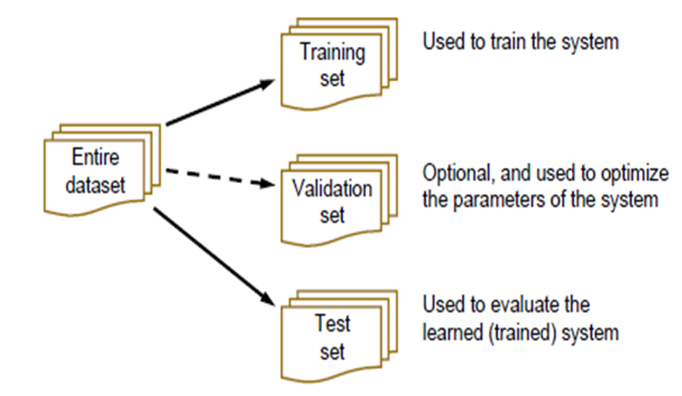
Evaluation Methods

Slide 44
Continued…
Hold out
Stratified Sampling
Cross validation
Bootstrap Sampling
Evaluation Metrics
F-Measure, Accuracy, Confusion Matrix
Significant tests

Slide 45

Contin….
Without proper understanding of distribution of the data, formulation of the problem, preprocessing, assumptions and presumptions of machine learning algorithms,
The analytics prediction is nothing but
"Lies, damned lies, and statistics“ - Mark Twain

Slide 46


